Slide 1
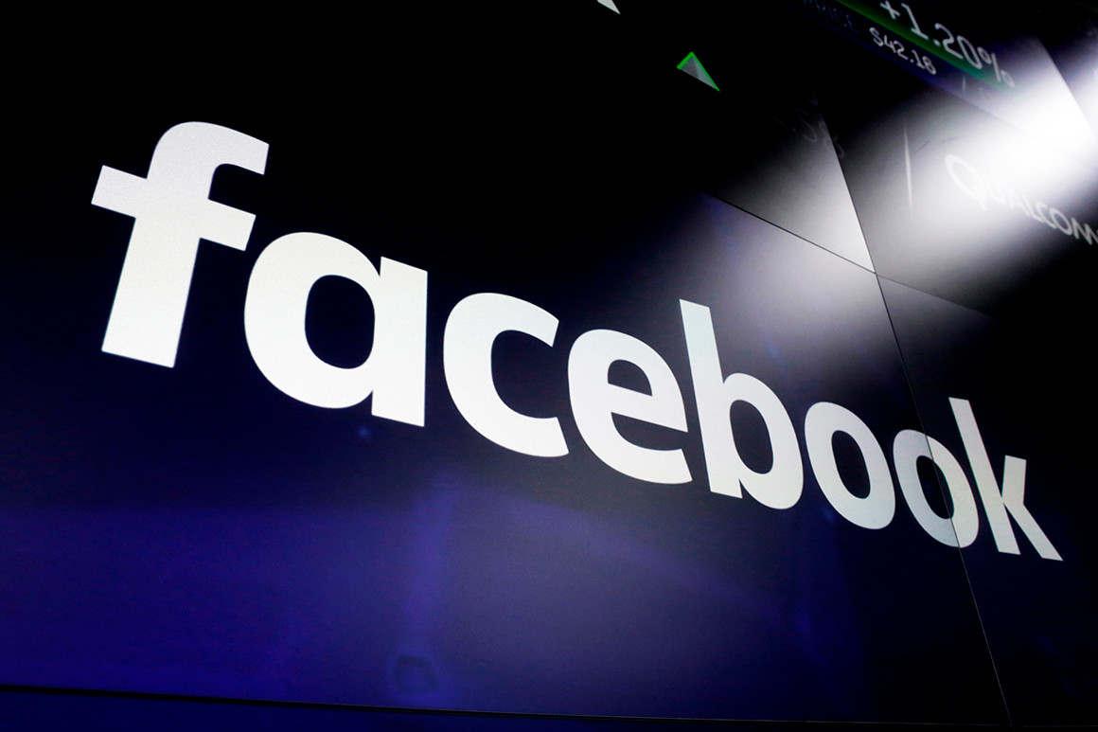
Russian Facebook Propaganda Efficacy Using Statistical Modelling
Authors: Donald Cooper,
Jan Danel,
Paul Franklin,
Pengwei Hu

Slide 2
Research Questions
Can we use a click-through rate to predict ad efficacy locally?
Can we accurately predict whether or not an ad is propaganda?
Notes:
Paul
Researchers seem to agree that a main russian goal was to fracture/sow disagreement in the country.

Slide 3
Facebook Data
We retrieved two datasets concerning Facebook Ads
Facebook Released Russian Ads
These ads were requested by the House Intelligence Committee that was created in order to investigate Russian interference in the 2016 General Election
User Scraped ProPublica Ads
These ads were compiled by ProPublica user by web scraping
Facebook wasn’t very transparent with its ads until it created the Ad Library in May 2018.
Launched the Ad Library Report which can be accessed by anyone and shows all ads, the publishers, and the amount spent among other things.

Slide 4
Russian Ad Data
Facebook Ads created by the Russian “troll” Internet Research Agency. Data collected by Facebook.
Raw data is 3,516 ads x 25 variables. Such as AdID, Impressions, Clicks, Location, and the text of the ad.
Outside data: Voting Statistics, Demographics, Median Household Income, and other data sets deemed useful.
All were collected through the U.S. Census Bureau’s Website.
Notes:
Paul

Slide 5
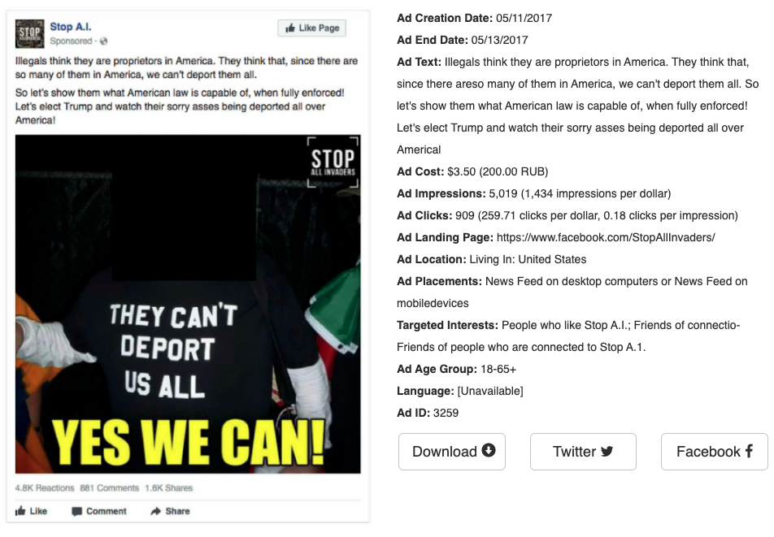

Examples
Notes:
Left: an instance of an inflammatory advertisement. Right: an example of a benign advertisement. The highly varied subject matter can make them deceiving.

Slide 6
ProPublica Ad Data
Also advertisements, but posted by legitimate public interest groups.
Collected from ProPublica users through scraping (possible objection)
Similar variables: ad text, target locations, target demographics, etc.
Notes:
Paul

Slide 7
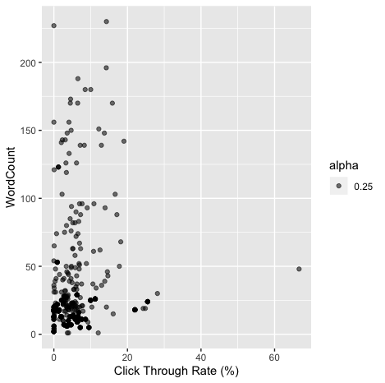
Outside Research
Others have found effectiveness to correlate with:
Number of words (Dutt)
Key word categorical variables (Boyd and Dutt)
Voting Turnout (Spangher)
% Identifying conservative (Because of Spangher p. 5)
Notes:
Paul
Compare this to Dutt

Slide 8
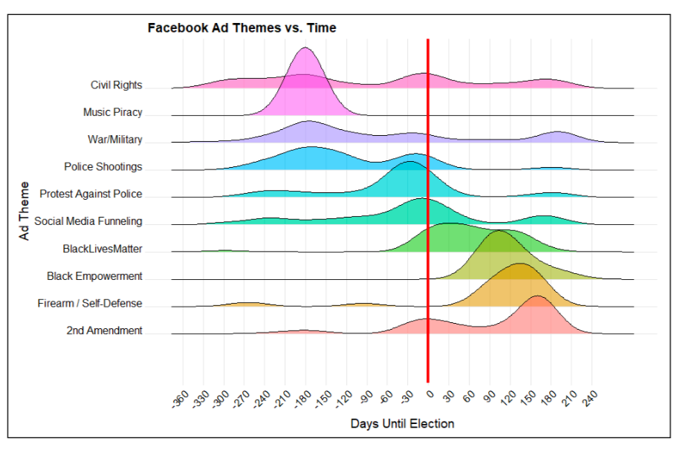
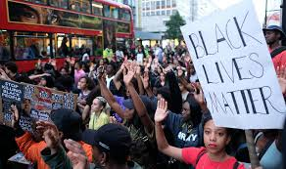
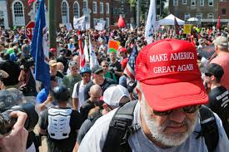
Outside Research
Notes:
Paul
This graph really helped us pick classification predictors

Slide 9
Why this Data?
We believed the additional data, from voting statistics to income level or demographics, would help us determine different levels of effectiveness:
Level of effectiveness on voter turnout between Democrats and Republicans; adding a base year for comparison (i.e. control group)
Level of effectiveness at different locations and/or cluster of locations
Level of effectiveness on different groups of people, whether it be race, income, poverty, etc.

Slide 10
The Two Models
MLR Fixed Effects Model w/ Jackknifing (State level)
Observations were categorized on state level.
This model reports ads distributed at the individual state level, creating a binary variable for each state, and tests them on a base category.
Transformations and resampling techniques are performed to improve validity and fit of model.
Classification Models
Response: 1=Propaganda, 0=Not Propaganda
Classification tree
Random Forest
GBM Boosted Model

Slide 11
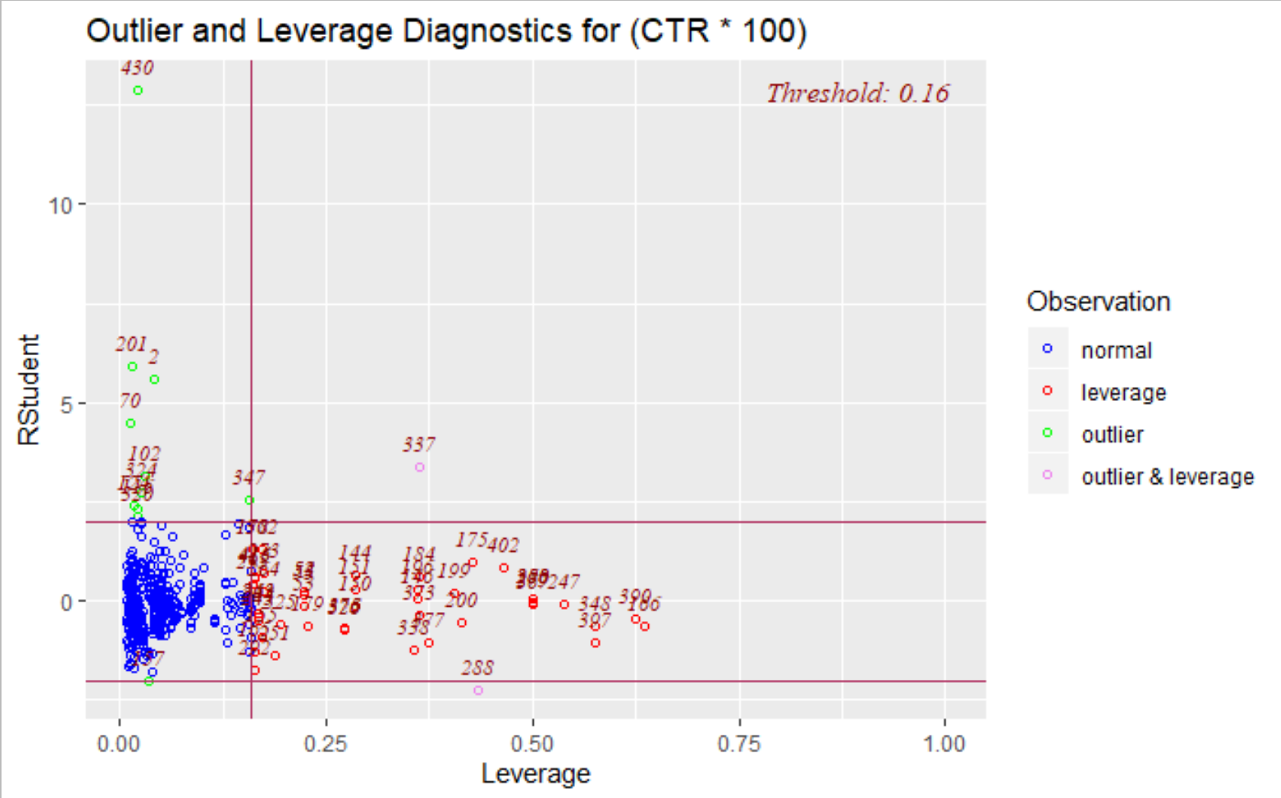
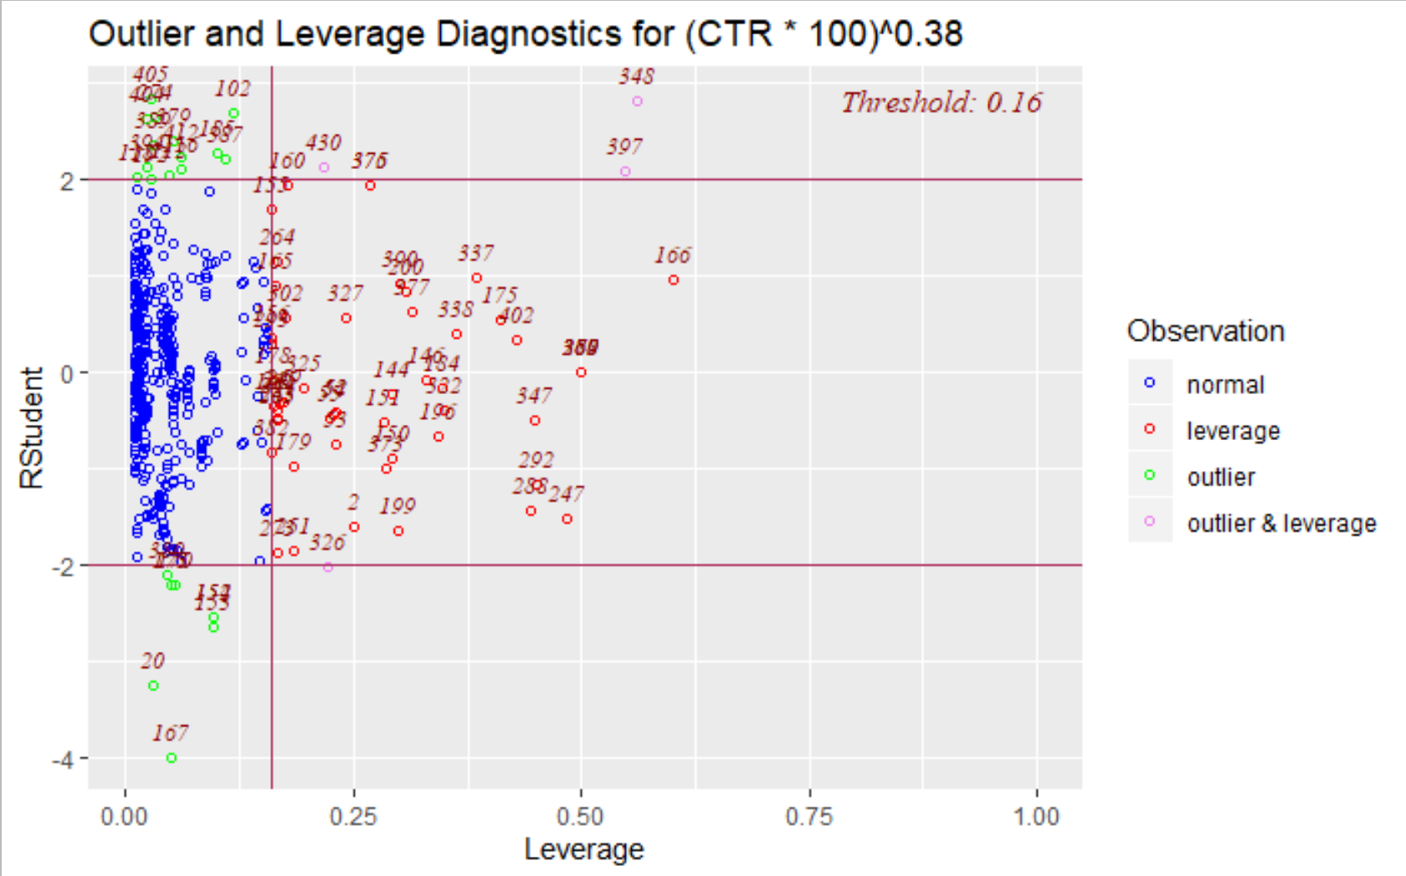
MLR Fixed Effects Model w/ Jackknifing (State level)
First Stage: MLR Model
Predictors include AdWordCount, AdDuration, Ad_Freq_state, ElectYear, state level dummies; Response was Click-through Rate (CTR)
Combining quantitative and qualitative predictors and observing model validity and significance
Overall model violates assumptions of linearity, normality and constant variance.
Second Stage: Transformed Model
Box-Cox and Box-Tidwell for variable transformation (lamda of .38 for CTR, square-root Ad_Freq_state).
Model assumptions met; conducted resampling procedures for improved model fit.
Final Stage: Jackknifed Model
Detects and leaves out one influential observation (#430 in this case).
Justification: low CTR->high error, and incorrect/NA data.
Leverage points #176, #250, #285, #366 ≯ 1 likely due to high count in Ad Duration and low value in CTR.
Comparison Between Original Model (Left) & Jackknife Model (Right) in Studentized Residuals and Leverage

Slide 12
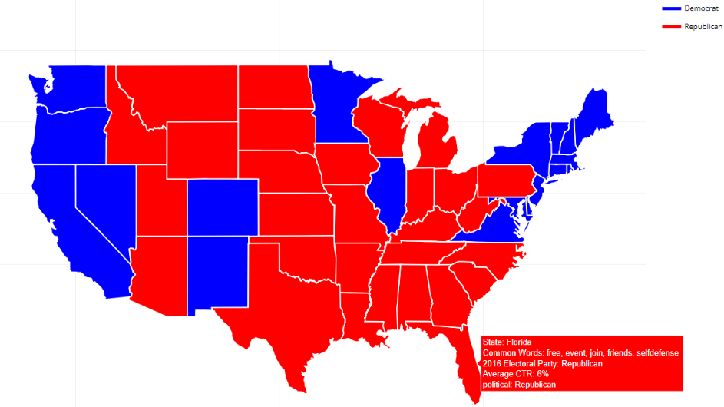
MLR Fixed Effects Model w/ Jackknifing (State level): Results and Interpretation
Jackknifed Model
Overall, the global F-test, where F(37, 438) = 128.01 revealed a significant model where the model p-value (~0.0001) was much less than 𝛂 = 0.05 and returned adjusted R-squared of ~0.91. Thus, after adjusting for sample size and degrees of freedom (n = 476, d.f. = 37), there is enough evidence to support that the predictors included within the Jackknifed model account for approximately 91% of the sample variance of the percentage change in Click-Through-Rate (CTR).
In other words, the model successfully showed that the average effect of our predictors on CTR percentage after controlling for state fixed-effects was either greater than or less the baseline (Maryland being the chosen baseline).
The Jackknife model was a successful attempt in model fit improvement. However, we do recognize that the increased overall fit was a trade-off between a better adjusted R-squared and perfectly met regression assumptions.
Russian Advertisement Top Words in Each State
This 2016 electoral map is color coded by the political party that won the electoral votes in the state. As an example, we see that by hovering over Florida we are able to see the most frequently used words in Russian ads, when getting rid of stop words. The five common words were “free, event, join, friends, selfdefense”. In combination with the regression model, we can determine the most influential content by association to CTR.

Slide 13
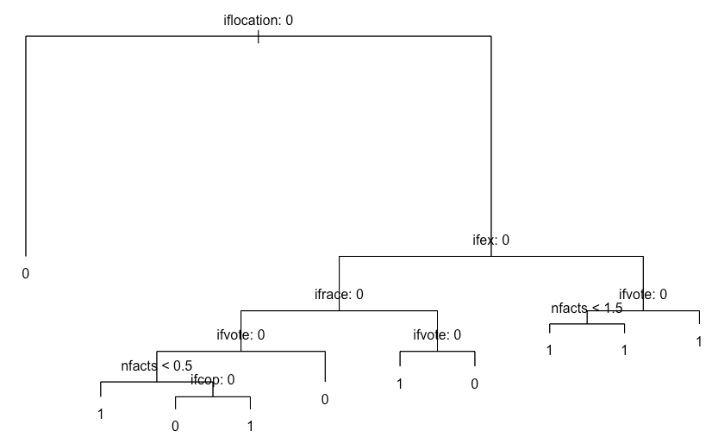
Propaganda Detection: Classification tree
Did the ad target a place frequently targeted by Russians?
Predictors:
Location
Syntactic features
‘Voting’ theme
‘Race’ theme
‘Cop’ theme
Factuality index
Some others (not included in this iteration)
Method:
Recursive Binary Splitting, semi Bagging
Gini index
Assumptions
None about predictor prob. distributions (it’s nonparametric), but equal groups
No. Yes.
Notes:
Paul

Slide 14
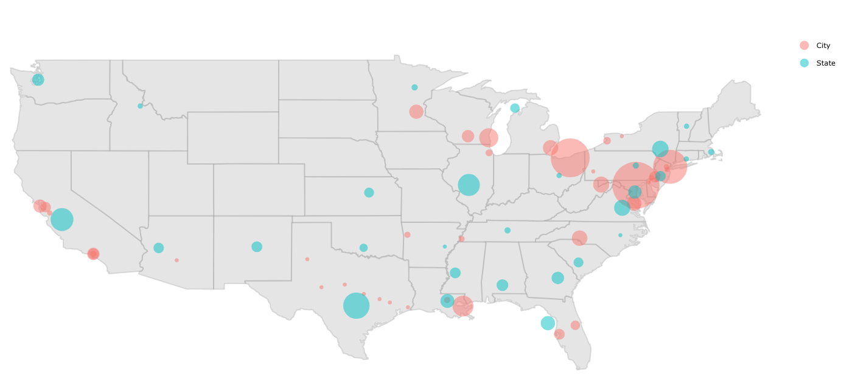
Propaganda Detection: Classification tree
Location Predictor: Number of Russian Propaganda Targets by State and City
Baltimore, Maryland:
Targeted 244 times
Notes:
Paul

Slide 15

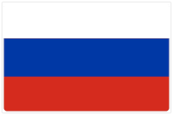
Propaganda Detection: Classification tree
Did the ad target the U.S. or a place frequently targeted by Russians?
Results (avg for 40 resamples wr):
Overall accuracy:
.8474
Sensitivity/True Positive Rate (Detection Rate):
.8726
Specificity/True Negative Rate:
.8224
No. Yes.
Notes:
Paul

Slide 16
Propaganda Detection: Random Forest, Boosting
Predictors:
Unchanged
Method:
Recursive Binary Splitting
Gini index
Tries subsets of predictors @ internal nodes
Predicts subsets of observations
Assumptions
None about predictor prob. distributions (it’s nonparametric)
Forest Results (avg for 40 resamples wr):
Overall accuracy:
0.8464
Sensitivity/True Positive Rate (Detection Rate):
0.8614
Specificity/True Negative Rate:
0.8317
Boosting Results (avg for 40 resamples wr):
Overall accuracy:
90.91%
Sensitivity/True Positive Rate (Detection Rate (%)):
91.95%
Specificity/True Negative Rate (%):
89.94%
Precision:
90.21%
Notes:
Paul

Slide 17
Potential Objections
Regression
Highly leveraged points (especially those with few predictor data points)
Solution: Check data one by one
CTR = measure of reception/agreement, not really coverage or russian prioritization
Classification
Time frame barely overlaps, ∴ compromised thematic predictors
Solution: More old data please
Convenience sample ∴ Propublica data not representative of all Facebook political ads
Solution: acquire ads randomly sampled from Facebook Ad Library

Slide 18
Conclusions
From the Jackknifed MLR Fixed-effects Model
Ads attempted to create chaos in the diverse social/political dynamics scattered across different populations across the United States.
IRA purposely targeted states with higher populations, often including major cities, as focal points for the dissemination of propaganda generating controversial topics or falsified facts during a range of three years which included a presidential election year.
States were targeted with ads of varied content, whether false or true, relatable to the political and/or sociological ideologies of those individuals within that state.
From the Classification Models
The classification models can fairly accurately predict whether or not an ad is propaganda. (41.95%>a useless model),
use class tree if worried about prop, else Boost
The most important predictors of ad legitimacy:
Location
Syntax
Message theme (race, then voting, violence, …)
Number of ‘facts’

Slide 19
Applications and Future Opportunities
Regression Applications
The regression model shows how key variables affect the efficacy of political advertisements.
Algorithm provides details on which ads are targeting and spreading within specific locations based on the content of the ad.
Companies involved in social media or marketing can take this information to understand the differences between how propaganda and actual sponsored advertisements affect different populations
Identifying reactions through social actions of these populations and whether or not ads are ethically sound.
Provides significant detail regarding how political ads, be it propaganda or legitimate, could potentially affect certain populations differently by the transmission of content.
Classification Applications
Anyone can predict (fairly accurately) whether an ad on their feed is propaganda*
Could detect malicious ads in the future, or at least save authorities and Facebook time and $$
Classification Future Research
Add variables like duration, or hour of week (Russians tend to work @ end of day, not on lunch break)
Try bagging, boosting, pruning, etc.
*Doesn’t mean they should: see our potential objections
Notes:
Tiger then Paul

Slide 20
Thank You!
https://pbf2tp.github.io/
https://jandanel.github.io/Fall-2020-Capstone/

